Slide 1

Video Games Market Analysis
Final Presentation
By
- Katherine LaConte
- Likhitha Varakala
- Manmitha Pantangi
- Shivam Sinha

Slide 2

Contents
Introduction
Data
AWS Architecture
AWS Services
Conclusion
Q&A

Slide 3

Video Game Market Analysis
Ever wonder what makes a successful video game?
What’s the ideal platform, publisher, and best-selling genre?
What are the predicted sales of a new game?
Notes:
LV

Slide 4

Data
Utilization of two datasets (game_sales_data.csv and vgsales.csv) for a comprehensive view of global video game market trends.
Jupyter Notebook facilitated data cleaning and preparation, crucial for reliable analysis.
Steps involved removing duplicates, handling missing values, converting data types for consistency, and merging datasets for a unified view.
The refined dataset enables in-depth video game industry analysis, supporting insightful queries, predictive modeling, and effective visualization of sales trends.
Notes:
LV

Slide 5

Cloud computing – AWS services
Deploy insights through QuickSight
ROLE SETUP
Create applicable roles & assign permission sets
INGEST DATA
Utilize AWS S3 buckets to store data
MODEL DATA
Create databases and tables to structure data in AWS Glue
Use Athena to query data and perform initial analysis / EDA
DASHBOARD
ANALYSIS
Notes:
LV

Slide 6
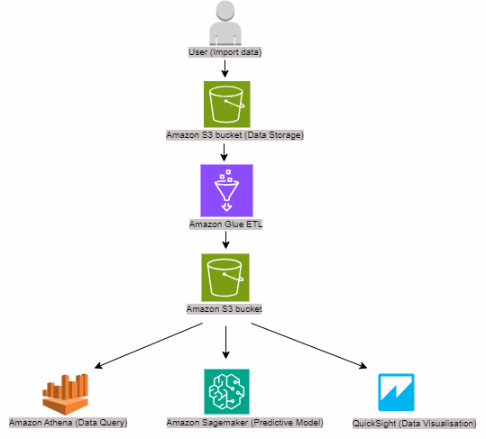
Cloud computing – AWS ARCHITECTURE
Notes:
LV

Slide 7
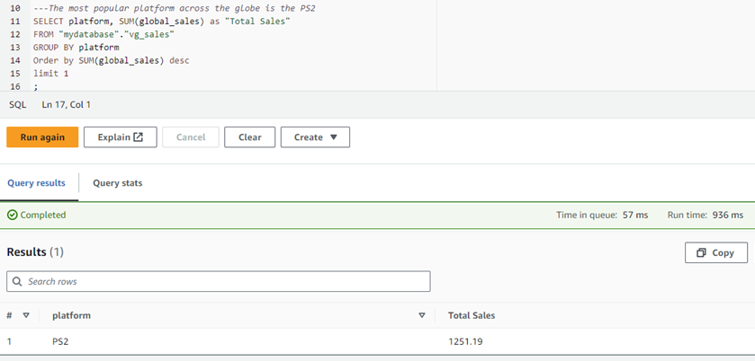
Analysis - ATHENA
What is the most popular platform across the globe?
Notes:
KL

Slide 8
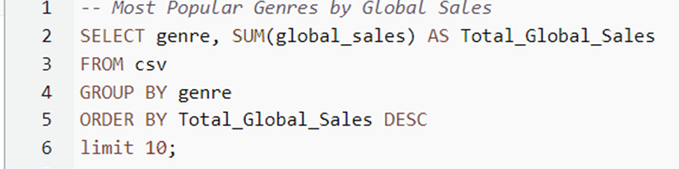
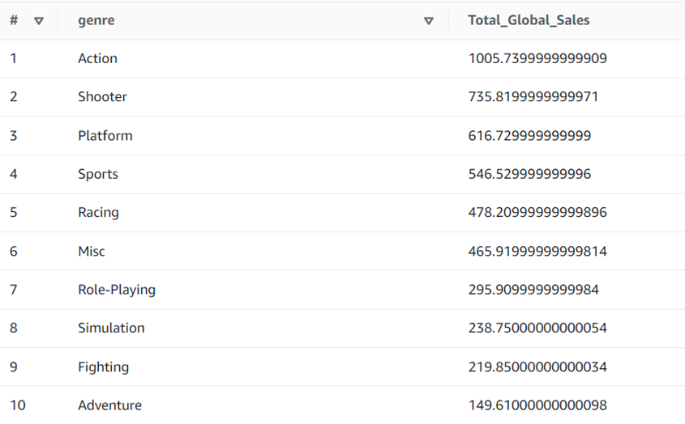
Analysis - ATHENA
What are the most popular video game genres across the globe?
Notes:
KL

Slide 9
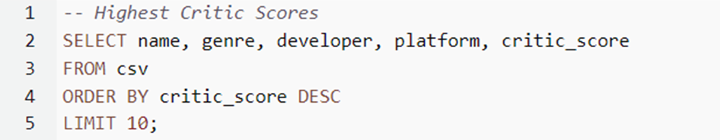
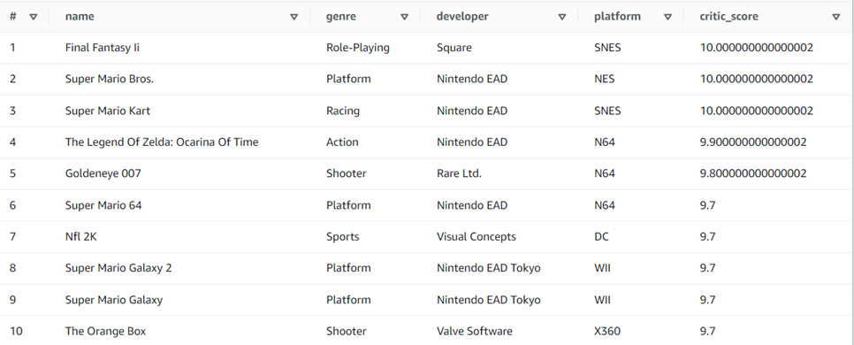
Analysis - ATHENA
What are the most popular video games by critic scores?
Notes:
KL

Slide 10
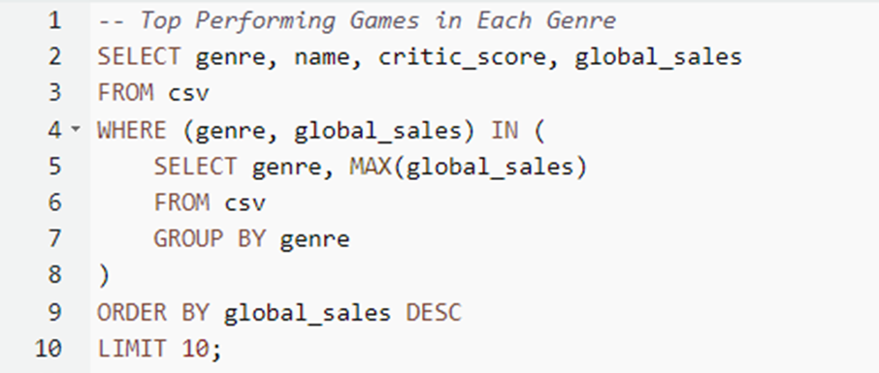
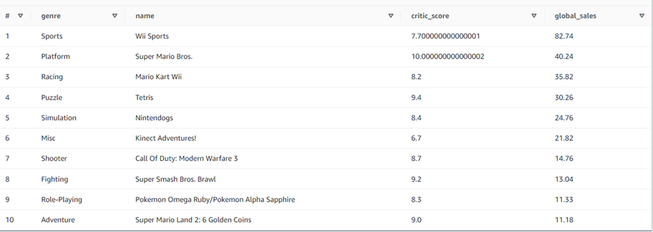
Analysis - ATHENA
What are the top performing video games in each genre?

Slide 11
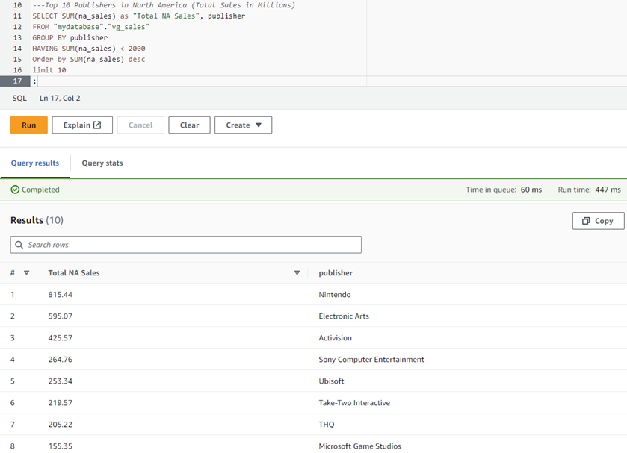
Analysis - ATHENA
Who are the top 10 publishers in North America?

Slide 12
Predictive regression model
We are creating a predictive model using a neural network for the task of estimating global sales in the context of video game data. Using this model, we can predict the global sales of an upcoming video game using its specifics based on how the data available. To train our model, we perform the following steps :
Data Loading and Preprocessing
Neural Network Model
Model Compilation
Data Splitting and Scaling
Model Training
Evaluation
Visualization
Notes:
SS

Slide 13
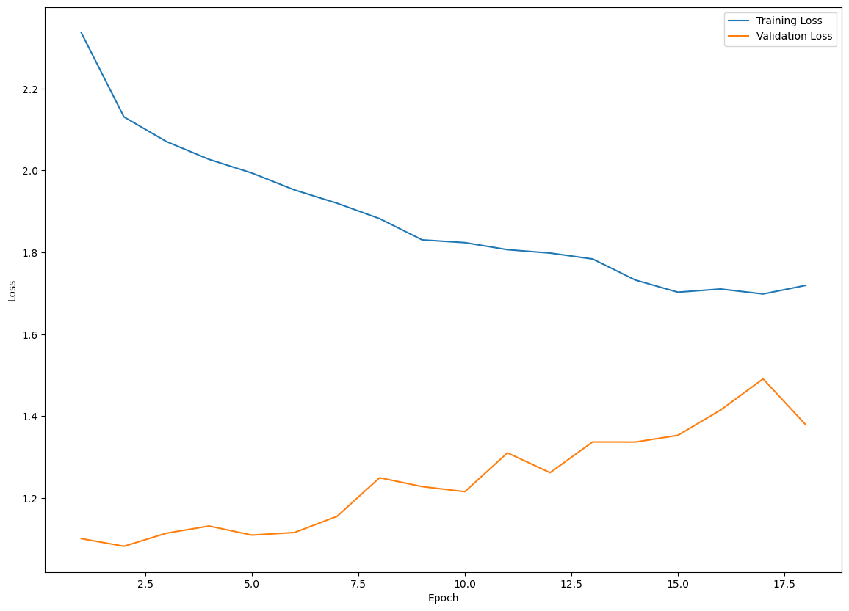
PREDICTIVE MODELING – AMAZON SAGEMAKER
The x-axis represents the number of training epochs, indicating how many times the model has iterated over the entire training dataset.
The y-axis represents the loss value, specifically the Mean Squared Error (MSE) in this case.
The plot shows two lines: one for training loss and one for validation loss.
The goal during training is to minimize both training and validation loss. If training loss decreases but validation loss increases, it may indicate overfitting.
Notes:
SS

Slide 14
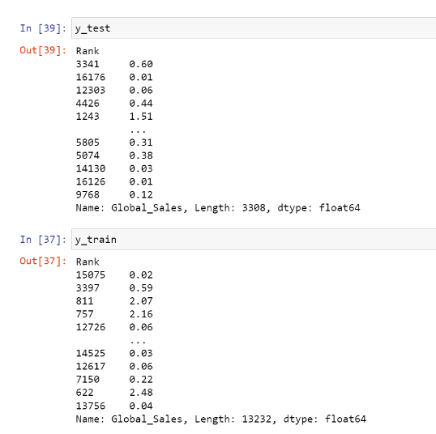
PREDICTIVE MODELING – AMAZON SAGEMAKER
We can see the values that were used to train the model using y_train, and the results for the test dataset using y_test.
As we can see, the prediction for global sales is shown opposite to the rank, as that is unique for every game. Variables like publisher, genre and platform are all included in the prediction model using one_hot_Encode() function.
Notes:
SS

Slide 15
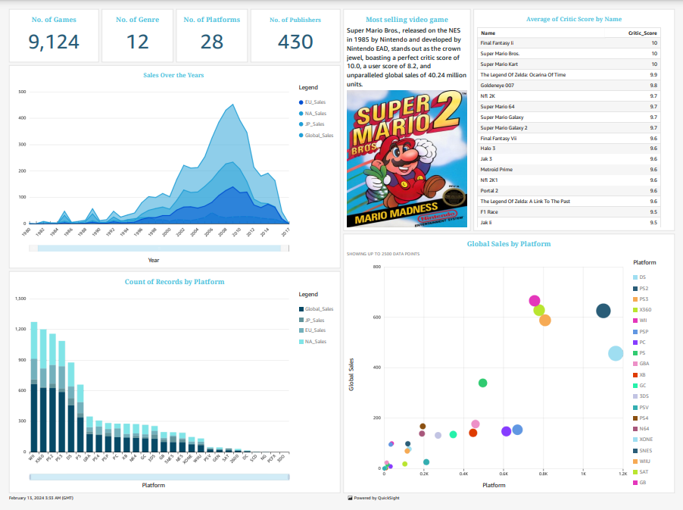
Dashboard
Notes:
MP

Slide 16
PROS & CONS
Pros:
Comprehensive Data Analysis
Advanced Cloud Computing Utilization
Innovative Predictive Modeling
Interactive Data Visualization
Cons:
Complexity of Data Preparation
Dependency on Cloud Services
Predictive Model Limitations

Slide 17

Future Recommendations:
*Action theme game
*PlayStation console
*Nintendo publisher
Super Mario Bros., released on the NES in 1985 by Nintendo and developed by Nintendo EAD, stands out as the crown jewel, boasting a perfect critic score of 10.0, a user score of 8.2, and unparalleled global sales of 40.24 million units.
Notes:
MP

Slide 18
Thank you

